Slide 1

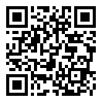

Club Welfare Officers
Club Male Welfare Officer
Club Name:
Welfare Officer:
Contact Number:
Email:
Insert photo of club welfare officer
^ Athletics NI- ^
Safeguarding
Club Female Welfare Officer
Club Name:
Welfare Officer:
Contact Number:
Email:
Insert photo of club welfare officer
Insert club logo

Slide 2
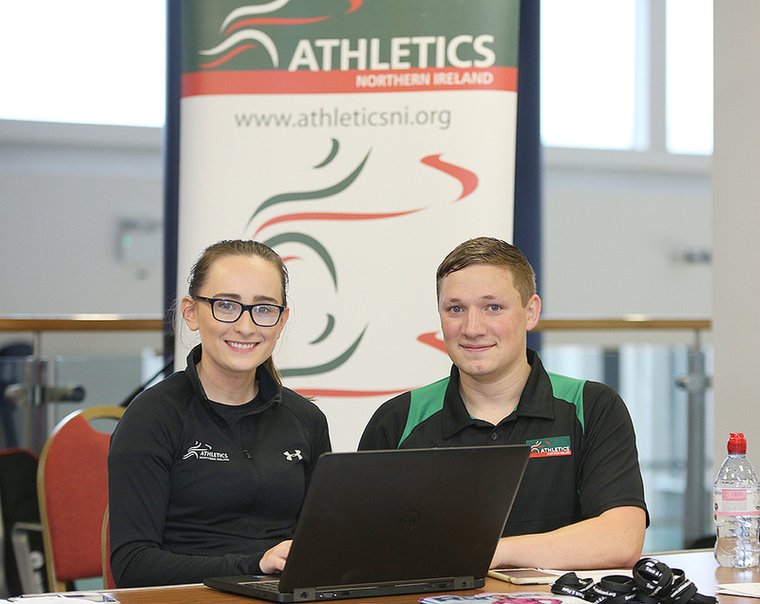
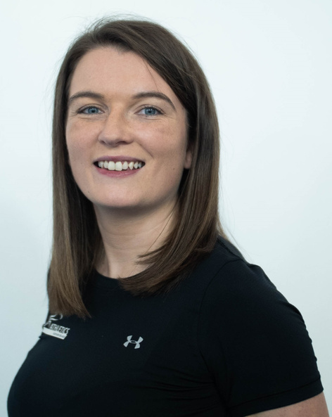
Club Welfare Officers
Athletics NI Welfare Officer
Name:
Allister Woods
Contact Number:
07379 125120
Email:
welfare@athleticsni.org
^ Athletics NI- ^
Safeguarding
Athletics NI Safeguarding Lead
Name:
Eilish Ward
Contact Number:
07917 901971
Email:
eilish.ward@athleticsni.org
Insert club logo

